Slide 1
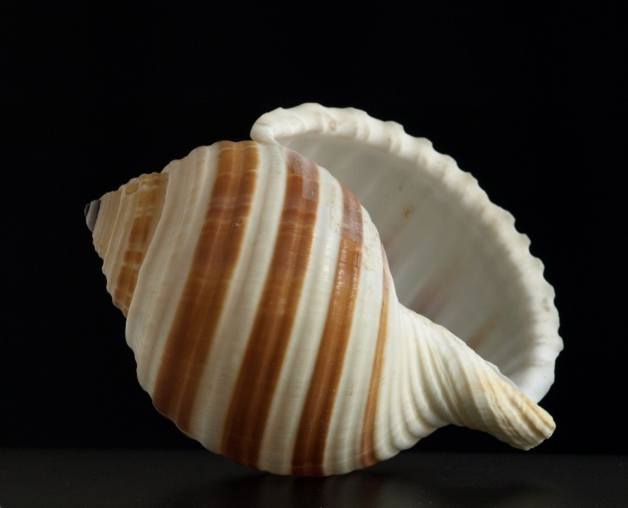
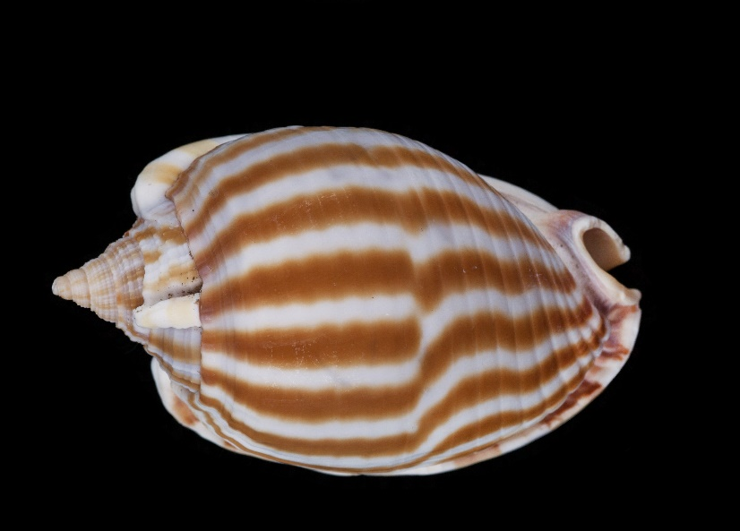
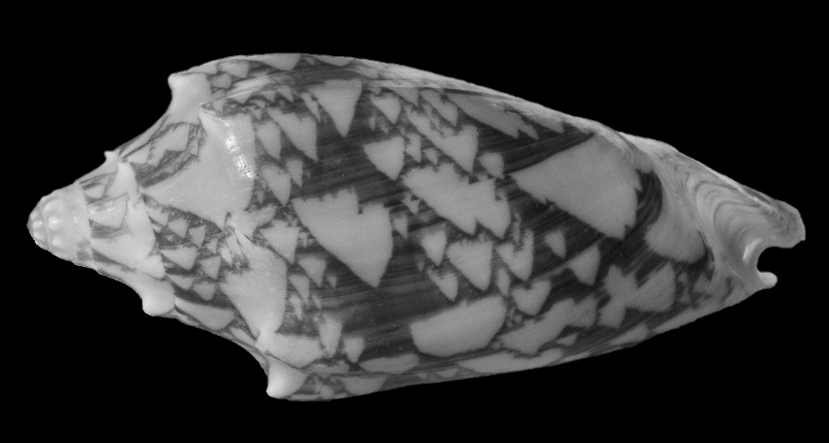
HOW DO SHELLS FORM PATTERNS?

Slide 2
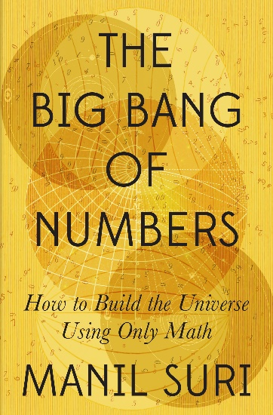
This material is adapted from my book, “The Big Bang of Numbers.”
Copyright ©Manil Suri, 2022

Slide 3
The process by which the mollusks living inside shells form patterns is very mathematical, even though it does not involve what we usually think of as mathematics!

Slide 4
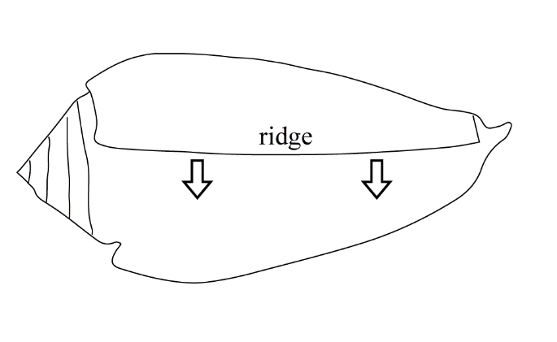
Mollusks create their patterns through a row of pigmentation cells on their mantle, a tongue-like protrusion that curls around the outer ridge of the shell. These cells turn “on” or “off” while the mantle secretes new material along the shell’s growing edge.

Slide 5
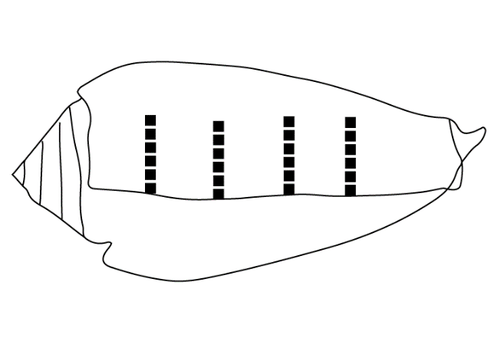
Some mollusks keep the same fixed selection of pigmentation cells activated indefinitely (with the rest off). This leads to stripes perpendicular to the outer edge.

Slide 6

What about stripes parallel to the edge?
These are created when a mollusk switches the entire row of pigmentation cells on for isolated bursts of time and leaves them off otherwise.

Slide 7
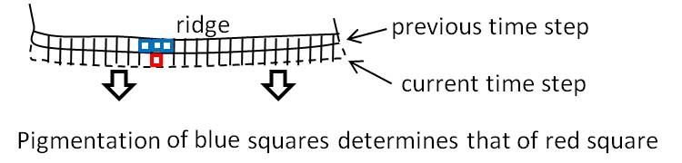
Fine, that’s how stripes form. But what about complicated patterns like this one?
These form when the mollusk switches each pigmentation cell on or off depending on what this cell, along with the adjacent cells on either side, did in the previous step.

Slide 8
For example, here is one strategy the cell might follow: Whenever one or two of the preceding three blue cells is on (i.e. pigmented), then the current red cell will also be on (i.e. pigmented). However, if all three of the preceding cells are on, then too much pigment is being used, so the cell switches off. Finally, if all three cells are previously off, the cell remains off.

Slide 9
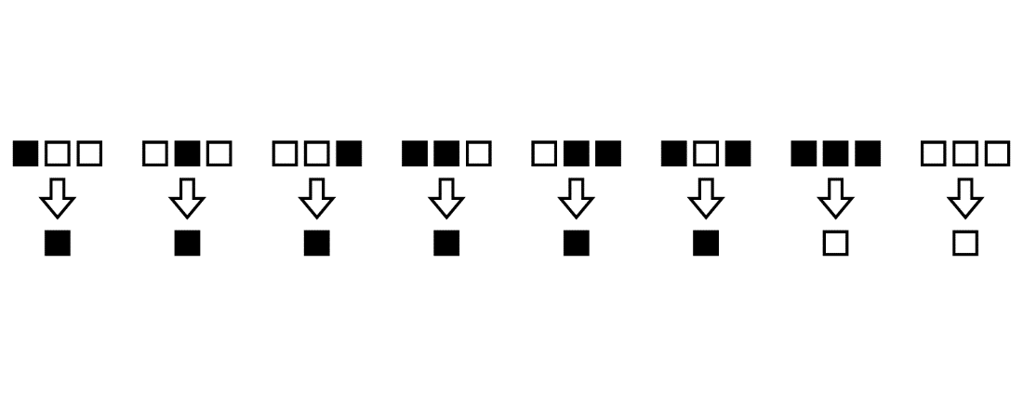
This rule can be represented by the above diagram. Notice there are eight different inputs possible, each of which gives an output. We call this an input/output rule. Let’s see what pattern it generates.

Slide 10
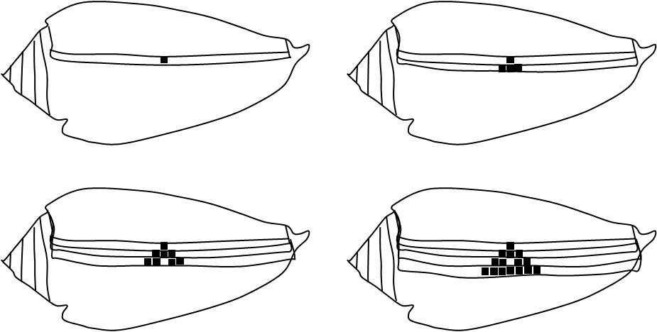
Start with a single pigmented cell. Then you can verify that at successive steps, you will see the following pattern develop.

Slide 11
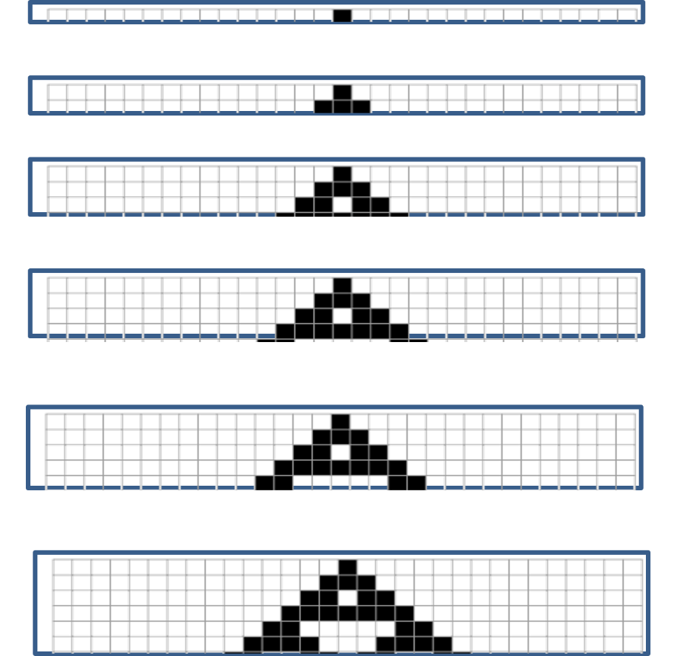
This can be presented as a nice puzzle for both kids and adults to try. They just need graph paper and a pencil. The steps they should obtain are as follows.

Slide 12
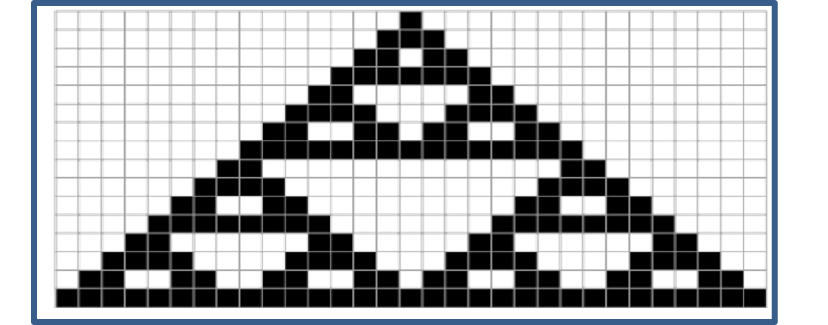
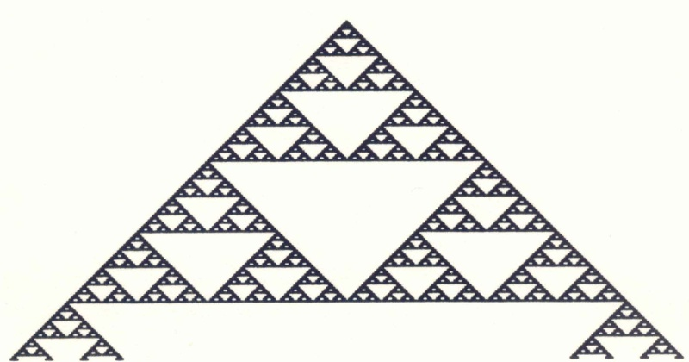
If they keep going, they will eventually get this pattern.
This is part of a “fractal” called the Sierpinski triangle. Notice how the pattern repeats at different scales as you zero in on it.

Slide 13
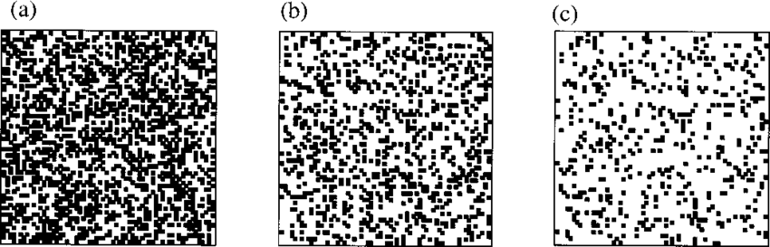
The shell pattern is similar, but much more complicated. What accounts for this?
For our pattern we started with a single pigmented square.
But what if we start with a random distribution of white and pigmented cells?

Slide 14
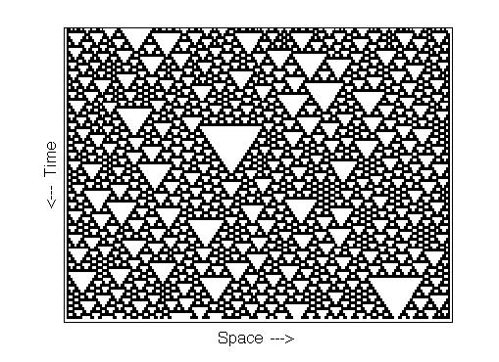
Then the pattern we get will also be random
This is what happens with actual shells
So we see Nature uses mathematics, but with some randomness thrown in!

Slide 15
There are many more input/output rules, which give rise to many different patterns. A complete list, along with the patterns generated, can be found at https://mathworld.wolfram.com/ElementaryCellularAutomaton.html
Refer to this website to create other such puzzles for people to try out. Some good ones are listed at the beginning.

Slide 16
This is just one example of how Nature uses mathematics. You can find many more in my book.

